Slide 1
Addressing the Intersection of Mental Health, Suicide, and Social Location
July 24, 2024
Ysabel Garcia, MPH

Slide 2
Funding and Disclaimer
The Suicide Prevention Resource Center at the University of Oklahoma Health Sciences Center is supported by a grant from the U.S. Department of Health and Human Services (HHS), Substance Abuse and Mental Health Services Administration (SAMHSA), Center for Mental Health Services (CMHS), under Grant No. 1H79SM083028.
The views, opinions, and content expressed in this product do not necessarily reflect the views, opinions, or policies of CMHS, SAMHSA, or HHS.

Slide 3
About SPRC
The Suicide Prevention Resource Center (SPRC) is the only federally funded resource center devoted to advancing the implementation of the National Strategy for Suicide Prevention. SPRC is supported through a grant from the U.S. Department of Health and Human Services Substance Abuse and Mental Health Services Administration (SAMHSA).
SPRC builds capacity and infrastructure for effective suicide prevention through consultation, training, and resources for state, tribal, health/behavioral health, and community systems; professionals and professional education programs; and national public and private partners.

Slide 4
Land Acknowledgement
We acknowledge that the land that now makes up the United States of America was the traditional home, hunting ground, trade exchange point, and migration route of more than 574 American Indian and Alaska Native federally recognized tribes and many more tribal nations that are not federally recognized or no longer exist.
We recognize the cruel legacy of slavery and colonialism in our nation and acknowledge the people whose labor was exploited for generations to help establish the economy of the United States.
We honor indigenous, enslaved, and immigrant peoples’ resilience, labor, and stewardship of the land and commit to creating a future founded on respect, justice, and inclusion for all people as we work to heal the deepest generational wounds.

Slide 5
Ysabel Garcia, MPH
Introduction

Slide 6
Overview
Connection Between Mental Health, Suicide, and Social Location
Community Care Circles
La Cultura Sana (The Culture Cures) Responder Training and Outreach Program

Slide 7
Connection Between Mental Health, Suicide, and Social Location

Slide 8
Mental Health, Suicide, and Social Location
Social location refers to the group memberships that people have due to their location in history and society. It includes race, class, gender, sexual orientation, religion, age, among others. (Adams et al, 2013)
Intersectionality states that the aspects of our social location do not exist independently from each other and are influenced by larger interpersonal and structural systems of oppression. (Bauer et al, 2021)
“Events occur in context, and because we live in a society that has not delivered on the promises of social justice… we have to structure into our analysis of a person’s death the context of social injustice in which they lived” (Reynolds, 2022)

Slide 9
Community Care Circles

Slide 10
What is Community Care?
Emphasizes mutual support and interconnected well-being
Recognizes systemic barriers and social determinants of health
Creates new structures to bridge resource gaps
Counterattacks isolation and improves mental health outcomes through collective support and solidarity within the community
Source: Mental Health America, n.d.
Notes:
2158042897

Slide 11
What are Community Care Circles?
Affinity spaces where individuals engage in meaningful storytelling through Indigenous circle practice and facilitated dialogue.
Participants gain a deeper understanding of themselves and others, develop stronger community bonds, and identify steps toward radical healing and growth.
Ultimately, the circles aim to empower individuals by validating their experiences with specific societal and cultural issues.
Notes:
2158042897

Slide 12
Community Care Circles Structure
Circle Opening
Intentions
Societal and Cultural Issue Introduction
One Mic
More than One Mic
Plant, Grow, and Weed Out
State a Need, Make a Request
Closing
Notes:
1329399963

Slide 13
Community Care Circles Frameworks
Liberation Psychology
Narrative Therapy
Intentional Peer Support
Cultural Humility
Compassionate Accountable Conversations
Notes:
97195610

Slide 14
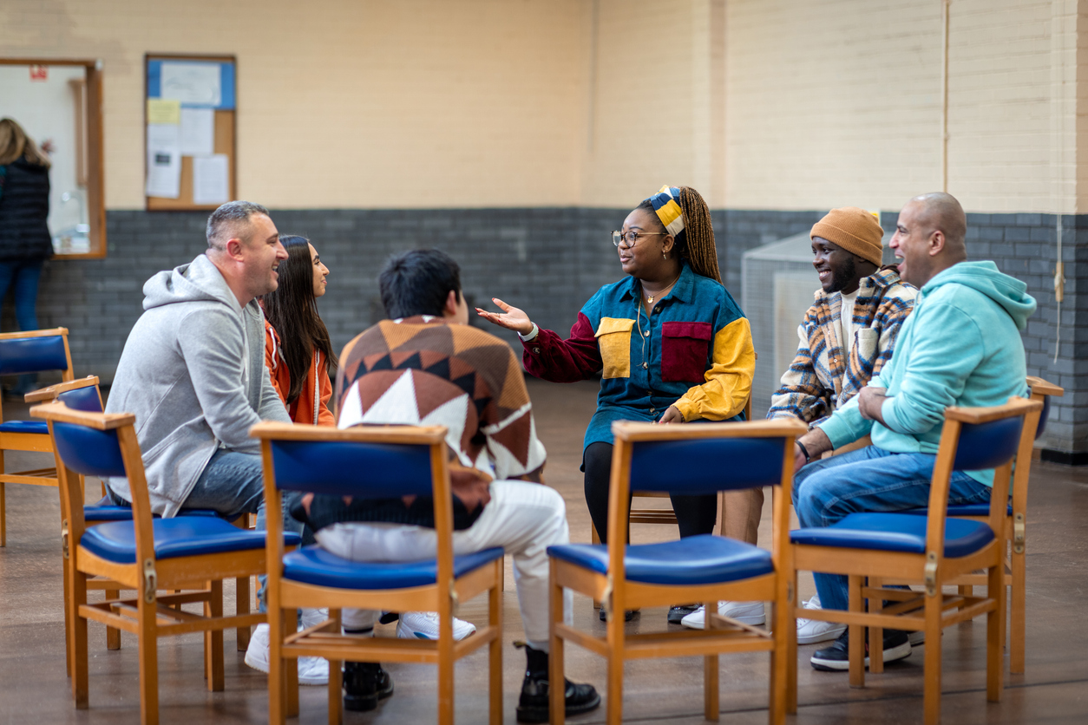
Community Care Circles Testimonials
“[A part of the CCC that impacted me positively was] knowing that many others experience similar struggles. Because we are POC, we can find ourselves wanting the same freedoms…” (Participant, Assimilation and Acculturation Circle)
“I was impacted positively by this CCC group because I was able to listen to others from many different backgrounds. I learned a lot of things about my own Spanish background that I didn’t know but makes so much sense to why and I how I was raised the way I was…” (Participant, Marianismo and Machismo Circle)
Notes:
1466736150

Slide 15
La Cultura Sana (The Culture Cures) Responder Training and Outreach Program

Slide 16
What is La Cultura Sana?
Source: New England Public Media, 2022

Slide 17
What is La Cultura Sana?
A Responder Training and Outreach Program for Cultural Mental Health Responders:
Hairstylists
Barbers
Doulas
Herbalists
Librarians
Bodega Owners
Bartenders
Nail Technicians
Notes:
1423350853

Slide 18
What is La Cultura Sana?
Our main objectives are:
Boosting responders’ confidence in assisting clients who are facing mental health issues
Lowering unwanted hospitalizations due to legal concerns and wellness checks
Offering resources in key neighborhood places to establish rapport and have conversations surrounding mental health support
Notes:
532752235

Slide 19
La Cultura Sana Responder Training Content
Jane Vella’s Dialogue Education Approach is used to address:
The intersection of customer service and mental health
The indicators of depression, anxiety, and suicidality
The social justice aspects of mental health
Peer support values
The use of peer support lines and hotlines as resources
Notes:
1384681280

Slide 20
Why La Cultura Sana?
Patients who perceived coercion during hospitalization admission were more likely to make a suicide attempt after discharge than those who did not. (Jordan & McNiel, 2020).
There have been 9,767 fatal police shootings since 2015 in the U.S. Twenty percent of victims reported having a mental health crisis. (Washington Post, 2024)
White adults were more likely to receive professional mental health care before and during the pandemic compared to Black, Hispanic, and Asian adults. (Thomeer, Moody, & Yahirun, 2023)

Slide 21
La Cultura Sana Testimonials
“The trainer was excellent at interacting with the audience and making sure we understood what she was saying. She did not assume what our base level of information was and instead asked us to tell her what our relationship with our customers is and tailored her recommendations with that in mind…" (Participant, Responder Training for Librarians)
“Ysabel created an incredible container and incredible mood for this skill share. Also, Ysabel grounded and embodied me into the community care values in a way that felt so sweetly groundbreaking today…” (Participant, Responder Training for Herbalists)
Notes:
1315042432

Slide 22
Questions?
Notes:
Tip: Use any photo you want here! To replace this photo, click on photo box and right-click. Select “change picture.”

Slide 23
Resources
Suicide Prevention Resource Center: www.sprc.org
Substance Abuse and Mental Health Services Administration: www.samhsa.gov
National Action Alliance for Suicide Prevention: www.actionallianceforsuicideprevention.org

Slide 24
References
Adams, M., Blumenfeld, W. J., Castañeda, C., Hackman, H. W., Peters, M. L., & Zúñiga, X. (Eds.). (2013). Readings for diversity and social justice. Routledge, Taylor & Francis Group.
Bauer, G. R., Churchill, S. M., Mahendran, M., Walwyn, C., Lizotte, D., & Villa-Rueda, A. A. (2021). Intersectionality in quantitative research: A systematic review of its emergence and applications of theory and methods. SSM - Population Health, 14, 100798. https://doi.org/10.1016/j.ssmph.2021.100798
Jordan, J. T., & McNiel, D. E. (2020). Perceived coercion during admission into psychiatric hospitalization increases risk of suicide attempts after discharge. Suicide & Life-Threatening Behavior, 50(1), 180–188. https://doi.org/10.1111/sltb.12560
Mental Health America. (n.d.). Community care. https://mhanational.org/bipoc-mental-health/community-care
New England Public Media. (2022). Estoy Aquí Responder program addresses mental health inequities | Connecting Point | Dec. 1, 2022 [Video]. YouTube. https://www.youtube.com/watch?v=9SV2IA-q30Q
Notes:
Note: References should be in APA style and in alphabetical order. References should not be numbered.

Slide 25
References
Reynolds, V. (2022). Hate kills: A social justice response to “suicide.” In J. White, I. Marsh, M. J. Kral, & J. Morris (Eds.), Critical suicidology: Transforming suicide research and prevention for the 21st century (pp. 169-187). University of British Columbia Press.
Thomeer, M. B., Moody, M. D., & Yahirun, J. (2023). Racial and ethnic disparities in mental health and mental health care during the COVID-19 pandemic. Journal of Racial and Ethnic Health Disparities, 10(2), 961–976. https://doi.org/10.1007/s40615-022-01284-9
Washington Post. (2024). Fatal force: Police shootings database. https://www.washingtonpost.com/graphics/investigations/police-shootings-database/
Notes:
Note: References should be in APA style and in alphabetical order. References should not be numbered.

Slide 26
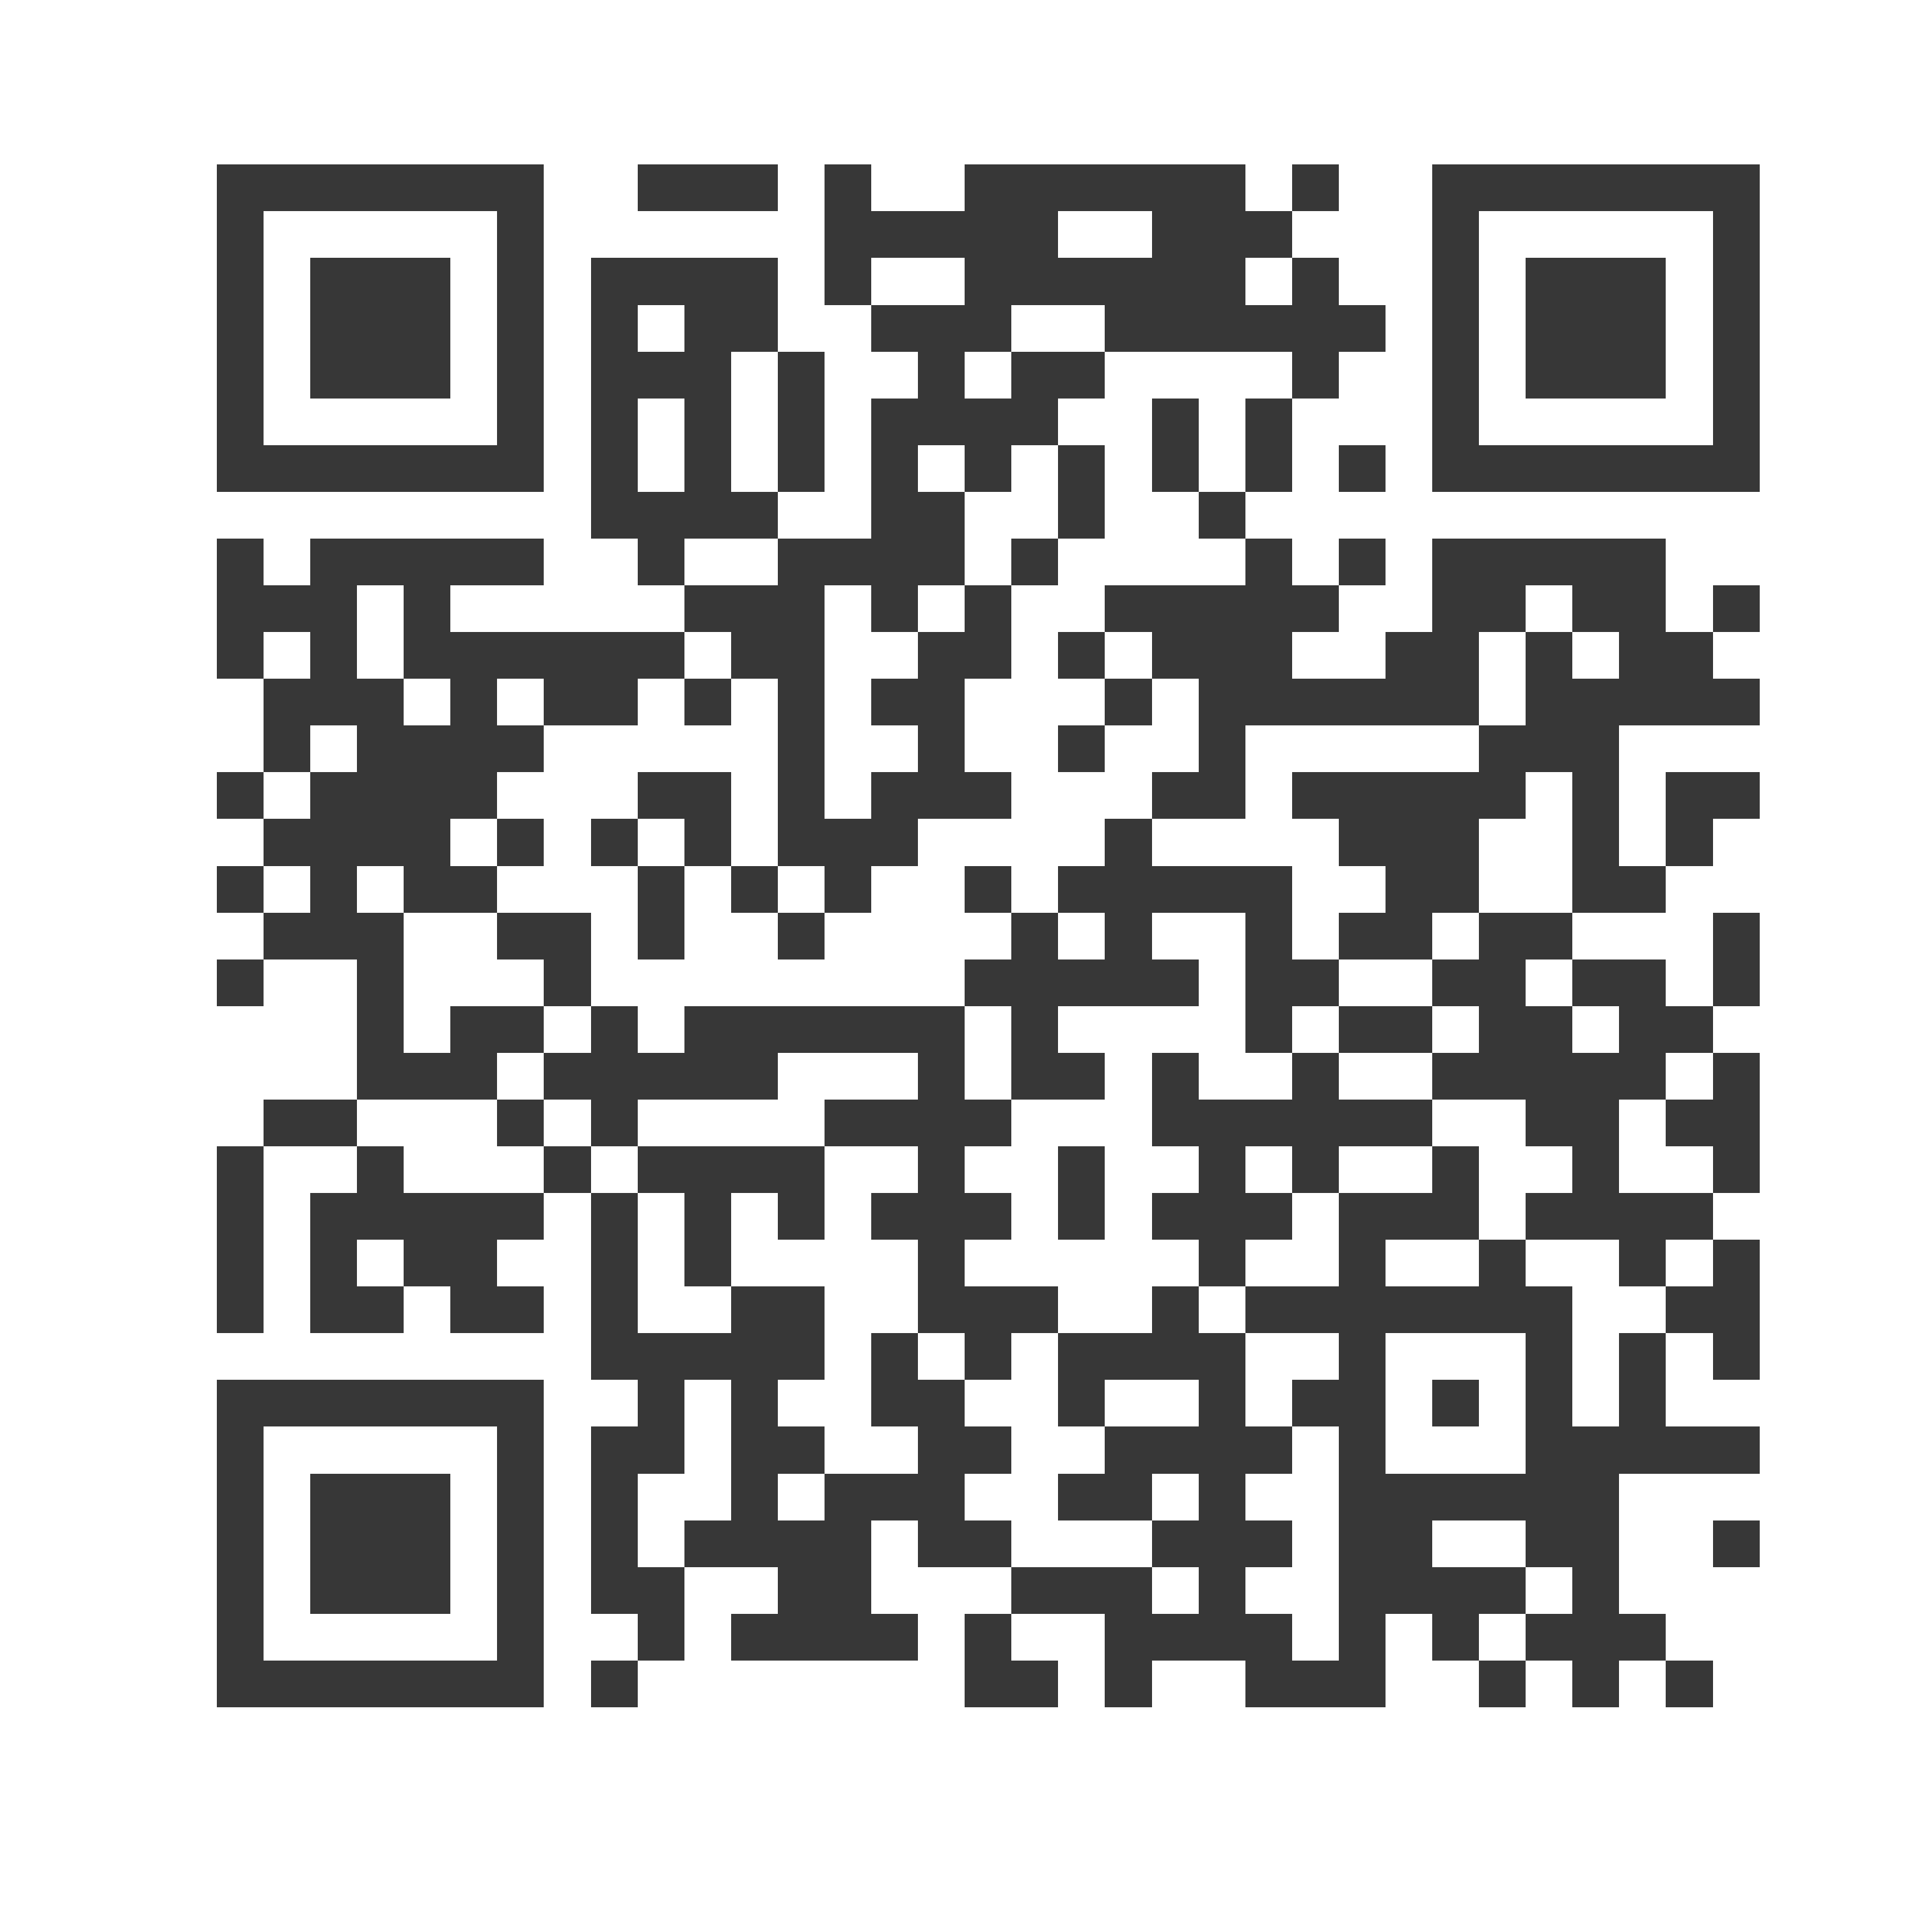
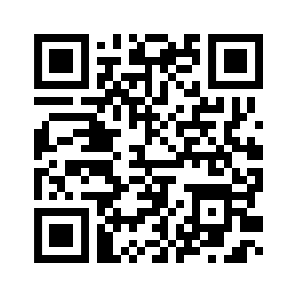
Thank you!
Ysabel Garcia
estoyaquicommunity@gmail.com
Subscribe to the Weekly Spark
Sign up to receive the latest news, research, and announcements from SPRC delivered to your inbox.

