Slide 1
Equity in Suicide Prevention: Access and Impact
June 18, 2024
Victor R. Armstrong, MSW
Vice President for Health Equity and Engagement
American Foundation for Suicide Prevention (AFSP)

Slide 2
Funding and Disclaimer
The Suicide Prevention Resource Center at the University of Oklahoma Health Sciences Center is supported by a grant from the U.S. Department of Health and Human Services (HHS), Substance Abuse and Mental Health Services Administration (SAMHSA), Center for Mental Health Services (CMHS), under Grant No. 1H79SM083028.
The views, opinions, and content expressed in this product do not necessarily reflect the views, opinions, or policies of CMHS, SAMHSA, or HHS.

Slide 3
About SPRC
The Suicide Prevention Resource Center (SPRC) is the only federally funded resource center devoted to advancing the implementation of the National Strategy for Suicide Prevention. SPRC is supported through a grant from the U.S. Department of Health and Human Services Substance Abuse and Mental Health Services Administration (SAMHSA).
SPRC builds capacity and infrastructure for effective suicide prevention through consultation, training, and resources for state, tribal, health/behavioral health, and community systems; professionals and professional education programs; and national public and private partners.

Slide 4
Land Acknowledgement
We acknowledge that the land that now makes up the United States of America was the traditional home, hunting ground, trade exchange point, and migration route of more than 574 American Indian and Alaska Native federally recognized tribes and many more tribal nations that are not federally recognized or no longer exist.
We recognize the cruel legacy of slavery and colonialism in our nation and acknowledge the people whose labor was exploited for generations to help establish the economy of the United States.
We honor indigenous, enslaved, and immigrant peoples’ resilience, labor, and stewardship of the land and commit to creating a future founded on respect, justice, and inclusion for all people as we work to heal the deepest generational wounds.

Slide 5
Victor R. Armstrong, MSW Vice President for Health Equity and Engagement American Foundation for Suicide Prevention (AFSP)
Introduction

Slide 6
Overview
What is Equity?
How Do We “Embed” Equity Into Our Work?
Examples of Equity in Action

Slide 7
Equity is Really About Access and Impact
Cultural Relevance
Relatable
Willingness to Access

Slide 8
What We Know About Suicide Prevention
Open supportive dialogue can lead to lifesaving action and interventions.
A robust, non-punitive, non-stigmatizing system, informed by lived experience and accessible to historically marginalized communities is protective against suicide risk for the entire population.
Providing evidence-informed, culturally sensitive, risk-reducing clinical care for patients and families where they live, work, play, and pray saves lives.

Slide 9
Communities Are Relational and Built Upon Shared Lived Experience

Slide 10
Communities Have:
Shared sense of consciousness- What happens to you impacts me.
Emotional identification- A feeling of belonging together.
Common ends- Respect for language, culture, customs, and traditions.
Notes:
Accessibility – change box background colors

Slide 11
In Times of Crisis…
988 Suicide & Crisis Lifeline

Slide 12
What does belonging look like…and from whose lens?
Photo by unknown author is licensed under CC BY-NC-ND

Slide 13
An Emotionally Safe Community…
Promotes inclusive, equitable environment that reflects the diverse population served.
Creates a sense of belonging for all.
Values diverse backgrounds and experiences and recognizes diversity as strength.
Understands the nuances of race, culture, and ethnicity that may impact well-being as well as willingness to access resources.

Slide 14
Reducing Suicides in the Black and Brown Communities
Cross-cutting equity initiatives
Data and evaluation
Community education and awareness
Best practices (evidence based and community informed)
Training and technical assistance

Slide 15
The Roadmap to Change
Intentionally focus on suicide prevention programs targeting Black and brown communities
Leverage existing knowledge and expertise to understand how to best identify and develop promising practices
Create a public-facing awareness campaign that focuses on Black and brown communities
Incorporate an evaluation plan to identify the reach of each strategic priority and assess the impact of the overall initiative

Slide 16
Community Level Strategies

Slide 17
Community Level Interventions
Community-led initiatives (seek to join existing initiatives)
School-based approaches (i.e., MHFA)
Culturally-relevant community-based suicide prevention activities and mental health supports
Access to age-appropriate, evidence-based therapy modalities such as dialectical behavior therapy (DBT), attachment-based family therapy (ABFT), multisystemic therapy (MST)
Suicide-specific screening and safety planning for Black and brown youth and adults
Increasing access to care, especially crisis care (988)
Reducing access to lethal means
Supports to address social determinants of health

Slide 18
Embedding Equity
Earn trust from historically marginalized communities and incorporate voices of lived experience into mitigation strategies.
Create and follow a strategy of partnering with historically marginalized communities.
Seek to understand what collaboration looks like from the community’s perspective.
Be intentional about:
Training providers in cultural competence and cultural humility
Reviewing treatment models to make sure that treatments accounts for the realities of social drivers

Slide 19
Building Trusted Relationships
Form partnerships with community-based organizations and coalitions to increase access to care, reduce stigma, and improve outcomes among historically marginalized populations.
Work with community partners, community media, and grassroots messaging to educate communities, combat stigma, and address concerns about receiving treatment.
Embrace the mindset that community collaboration affords us the opportunity to provide not only an evidence-informed response, but also a community-informed response.

Slide 20
Building Partnerships
Leverage expertise of providers of color and providers with expertise in serving targeted groups (i.e., BIPOC, rural, elderly, LGBTQIA2S+, etc.) who have traditionally served historically marginalized communities, often without access to government grants and contracts.
Focus on justice-involved populations including rethinking how individuals seeking addiction treatment enter services. Court-ordered, legally enforced treatment shouldn’t be our strategy.

Slide 21
Measure What Matters
Ensure that your approach is data driven. Prioritize equity data by focusing on quantifying the disparities.
Develop and follow a data strategy that will identify the underlying social inequities and the resources needed to afford all residents a fair and just opportunity to achieve their healthiest outcome.

Slide 22
Evaluation Efforts…
Cannot be limited to measuring average impact on the health of a whole population.
Measure change in outcomes among selected disadvantaged groups
Quantify the size of gaps between disadvantaged and advantaged groups
Seek to engage disproportionally impacted communities in solution generation
Measure to determine if efforts have been successful

Slide 23
Where to Engage
Barbershops
Fraternities
Historically Black Colleges and Universities (HBCUs)
Faith Communities

Slide 24
Equity in Action

Slide 25
About L.E.T.S. Save Lives
A newly created (launched February 2024) national AFSP program offering a culturally sensitive approach to suicide prevention for Black and African American communities.
The program addresses the latest mental health findings and ways to reduce stigma, encourages connection and conversation, and increases suicide prevention awareness and help seeking.
The research-informed program follows the principles of Listening, Empathy, Trust, and Support (LETS), and will be delivered in local community settings by trained presenters from the community.

Slide 26
The Creation Process
Funded by grant from CVS Foundation (Jan '22 – Dec '23)
Informed and developed by an advisory committee representing a diverse group of experts
Leveraged expertise of Black, woman-owned design firm to create a program that would resonate with the Black community
Intended to be delivered by individuals who identify as Black or African American

Slide 27
“L.E.T.S. Save Lives” Program Goals
Create a suicide prevention education program tailored to Black and African American audiences throughout the United States.
Provide an understanding of the scope of the issue of suicide in the Black community, including the impacts of racial and systemic factors, risk and protective factors, warning signs, and how to get help for those who are struggling.

Slide 28
L.E.T.S. Save Lives Learning Objectives
Understand the scope of suicide among the Black and African American community
Understand the racial and systemic factors that impact the Black and African American community about suicide
Describe suicide risk and protective factors for Black and African American communities
Describe warning signs of suicide
Learn how to get help for someone in a suicidal crisis
Gain confidence in talking to someone about suicide

Slide 29
Pilot Process
Piloted by nine chapters across the country in fall of 2023
Conducted 13 program sessions with 317 total participants
The program was well received and liked:
100% of participants would recommend the program to others
61% of survey respondents indicated they had not heard of AFSP before
86% agreed that they view AFSP as a relevant resource for the Black community

Slide 30
Soul Shop for Black Churches
“
Access is not only about having physical proximity to traditional resources; it is about having resources available to me that are relatable to my lived experience and that I am willing to utilize.
Victor Armstrong, Director, Soul Shop for Black Churches
Equity in Suicide Prevention

Slide 31
“Faith-based Suicide Prevention Created by Black People, for Black People”
One-day workshop designed for clergy, staff, lay pastors, and faith-based clinicians in the Black Church.
Equips leaders who are on the front lines of the mental health crisis to minister to those impacted by all the faces of trauma and struggle regarding suicide, including:
Those who are considering suicide
Those who are concerned for family, friends, or associates who may be considering suicide
Suicide loss survivors
Suicide attempt/ideation survivors

Slide 32
Faith Leaders Learn:
How to prevent suicide in your community
The signs of suicide risk and warning signs
How to ask a person at risk if they might be thinking about suicide
How to be a companion to those experiencing suicide loss
About local and national resources available for suicide prevention
How to integrate suicide prevention into the life and ministry of the church

Slide 33
Why the Black Church?
The Black Church is well positioned to be a source of hope and healing for those impacted by suicide.
Gateway to reach and mobilize the Black community
Shapes religious and cultural norms as well as help- seeking behavior
Place of refuge and healing
Place of strong social connectedness and kinship
First place of social services, political activity, and social activism in the Black community
Long history of being used as a community partner for community health interventions (primary care, community metal health, health promotion, disease prevention)

Slide 34
“
As it pertains to equity, there will always exist a temptation to compare the current state of things to the past state of things, and celebrate how far we’ve come, rather than compare your current state to my current state and recognize how far we have left to go.
Victor Armstrong
Equity in Suicide Prevention

Slide 35
Questions?
Notes:
Tip: Use any photo you want here! To replace this photo, click on photo box and right-click. Select “change picture.”

Slide 36
Resources
Suicide Prevention Resource Center: www.sprc.org
Substance Abuse and Mental Health Services Administration: www.samhsa.gov
National Action Alliance for Suicide Prevention: www.actionallianceforsuicideprevention.org
American Foundation for Suicide Prevention State Policy Priorities: https://afsp.org/our-work/advocacy/public-policy-priorities/
Resources for Black Community: 988lifeline.org/help-yourself/black-mental-health
Trans Lifeline: https://translifeline.org/ 1-877-565-8860 (para español presiona el 2)
Veteran Crisis Line: https://www.veteranscrisisline.net 988, then select 1, or text 838255
Physicians Support Line: https://www.physiciansupportline.com/ 1-888-409-0141
Equity in Suicide Prevention

Slide 37
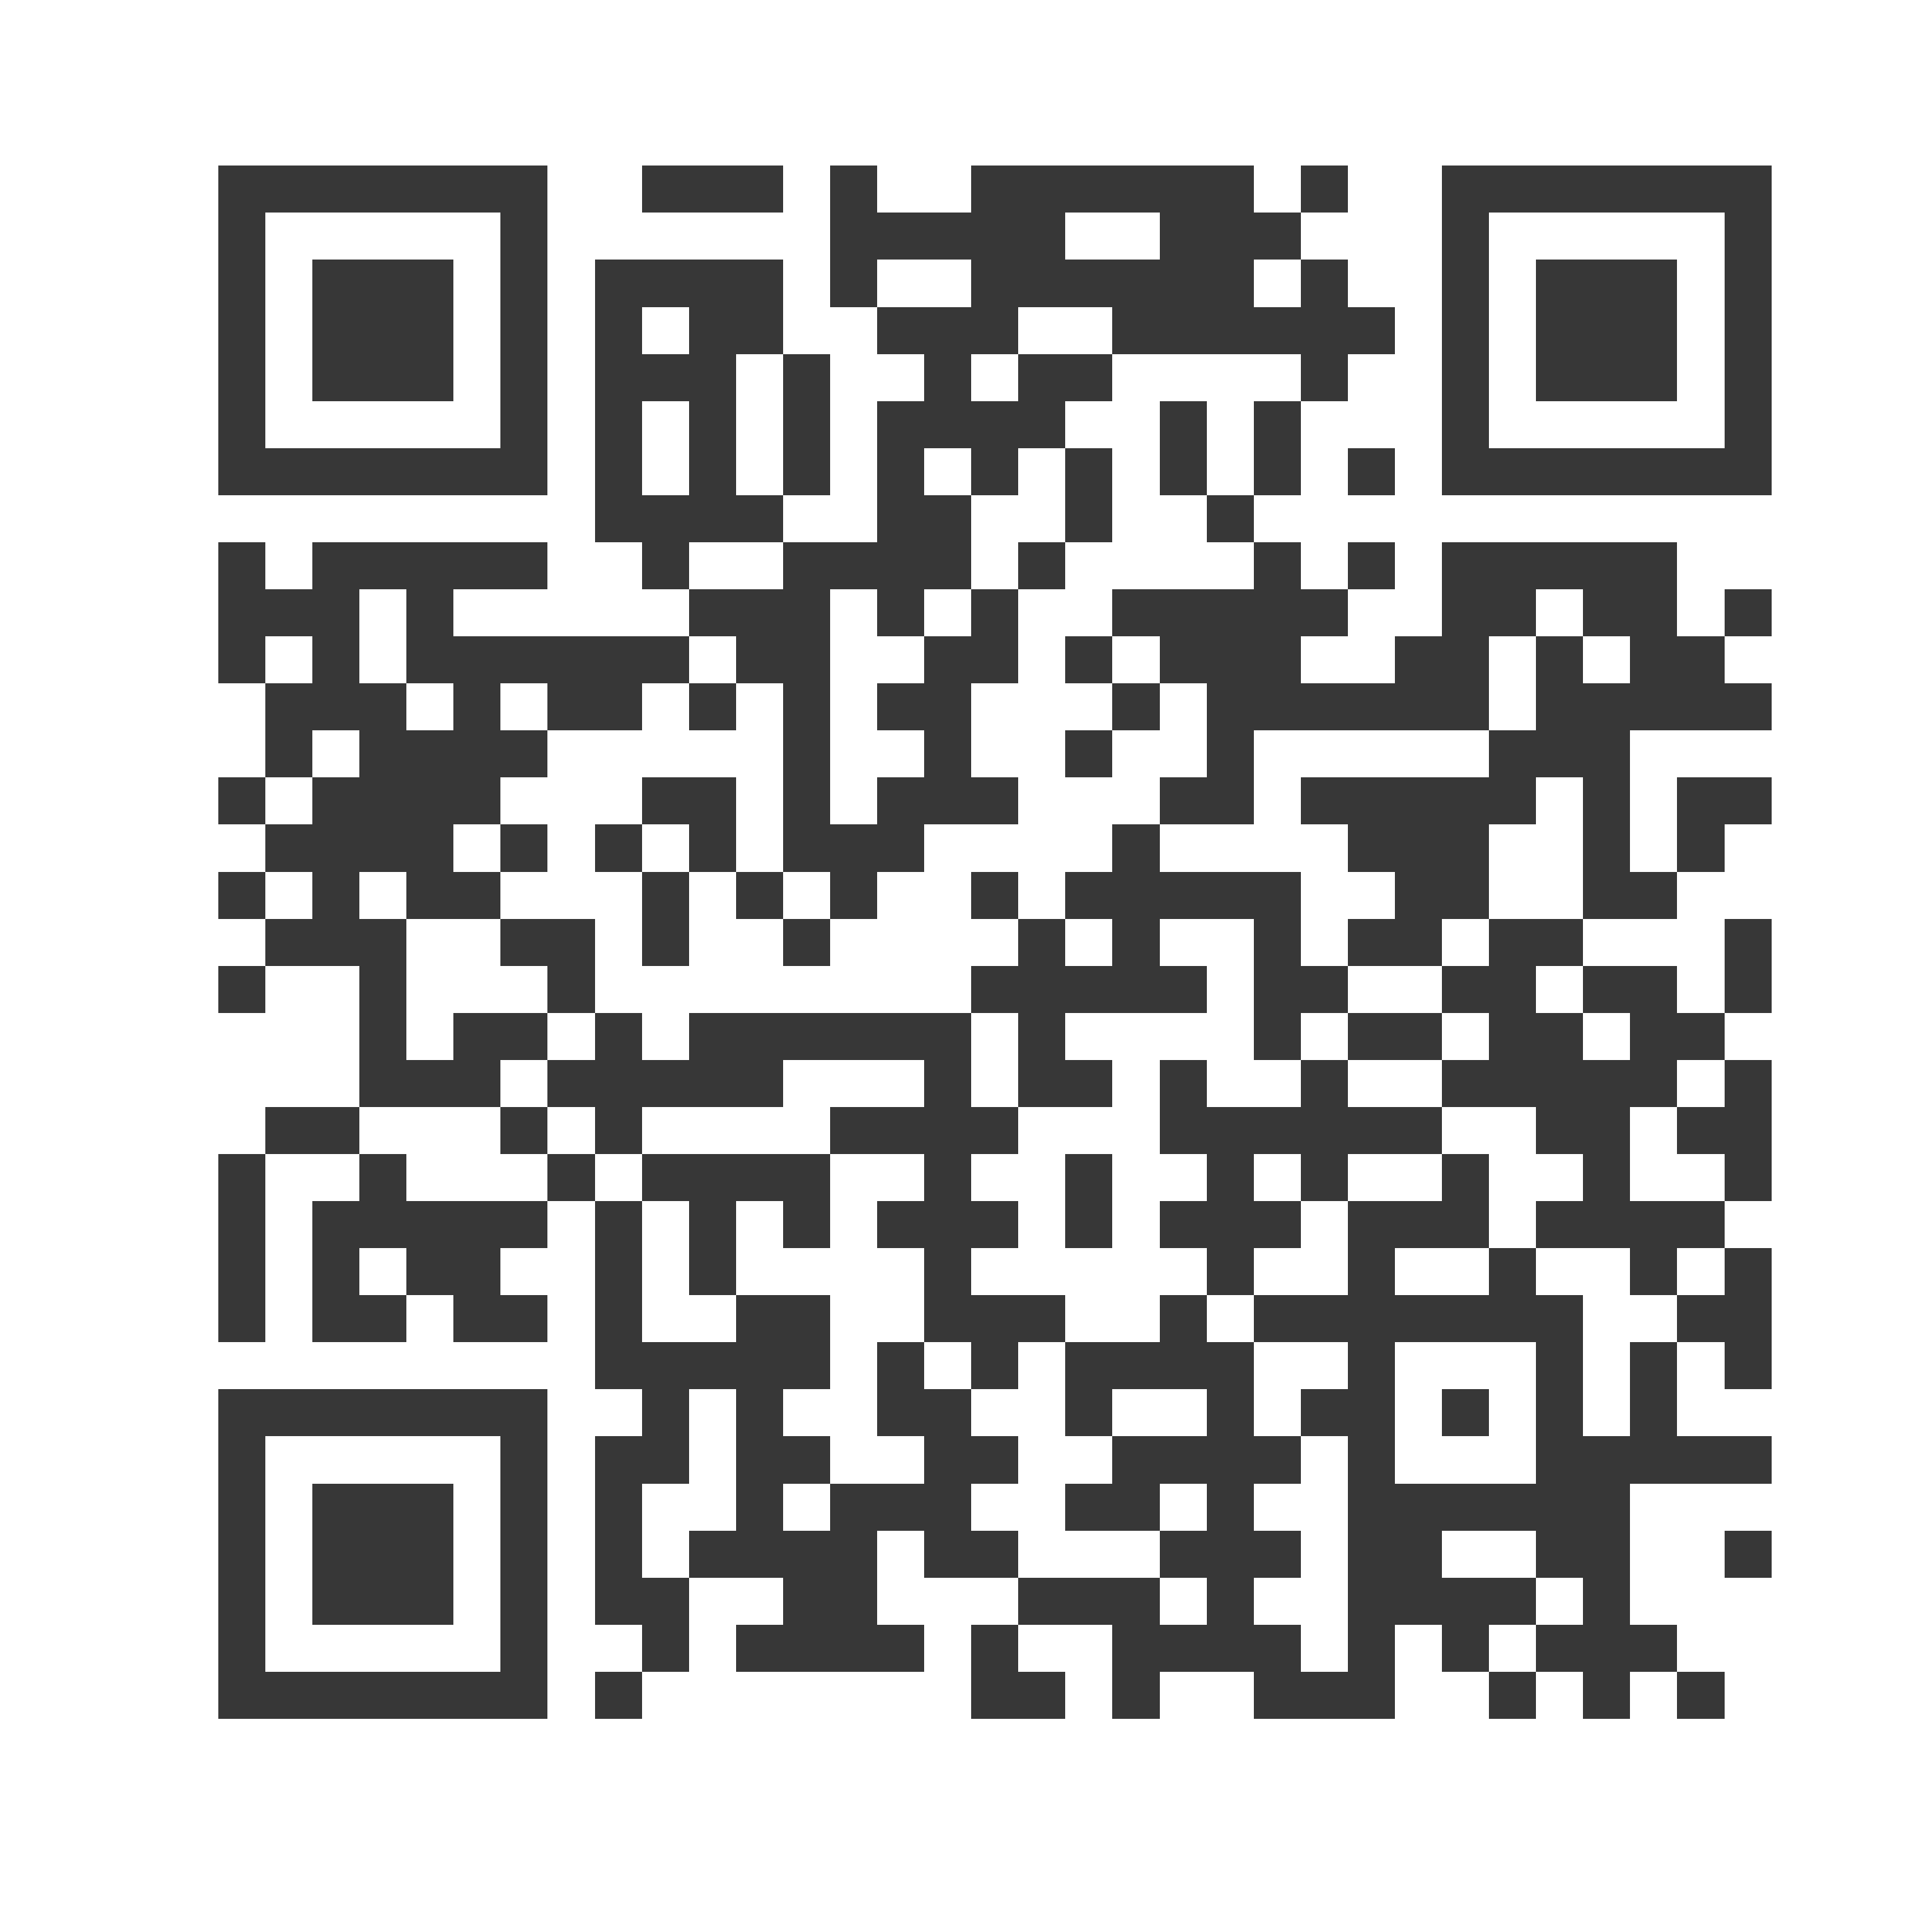
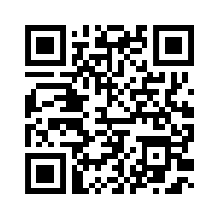
Thank you!
Vic Armstrong
varmstrong@afsp.org
X @1of2Vics
Facebook @1of2Vics
Instagram @1of2Vics
LinkedIn Victor Armstrong, MSW
Subscribe to the Weekly Spark
Sign up to receive the latest news, research, and announcements from SPRC delivered to your inbox.

